Slide 1


Benefits Portal
Employee Login Tutorial

Slide 2
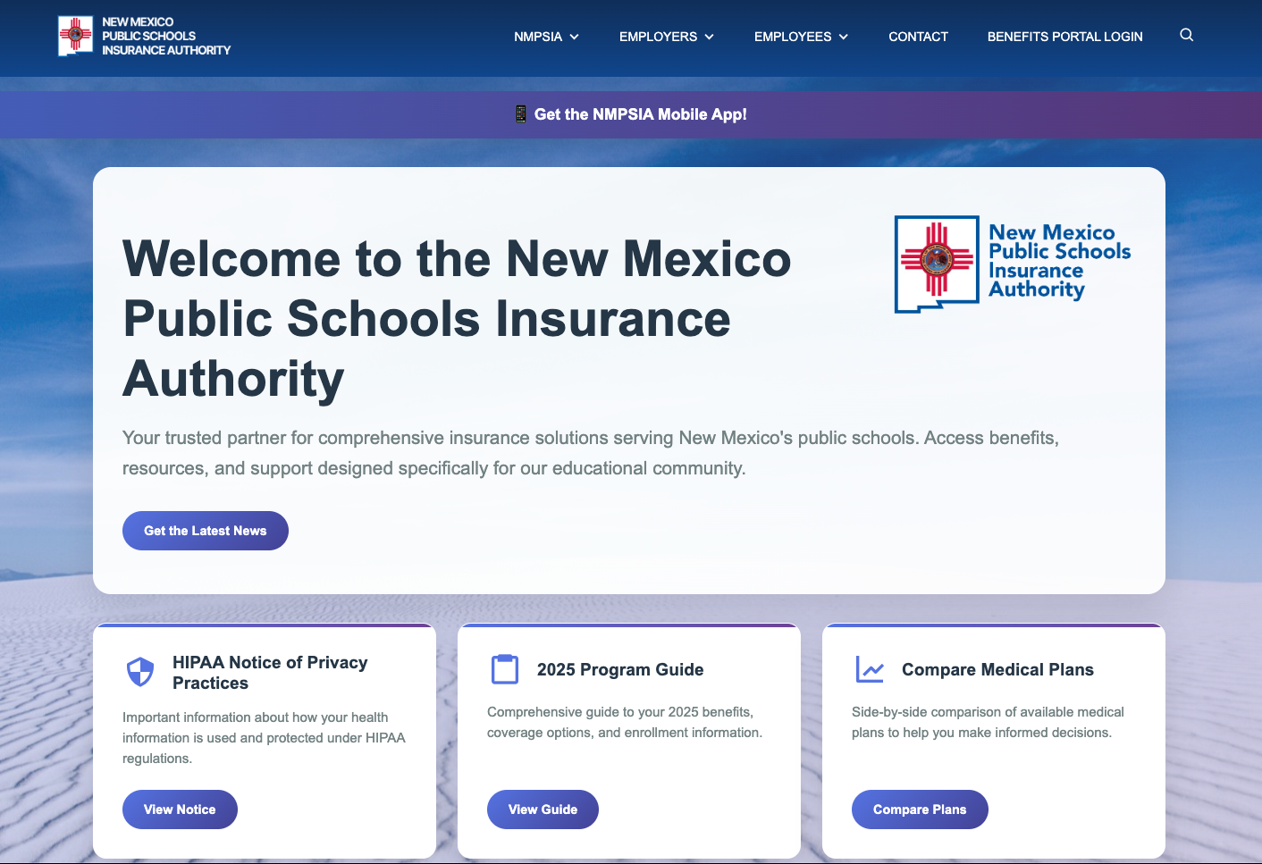
NEW USER To access NMPSIA’s Benefits Portal Go to NMPSIA.com and Click on “Benefits Portal Login”.

Slide 3
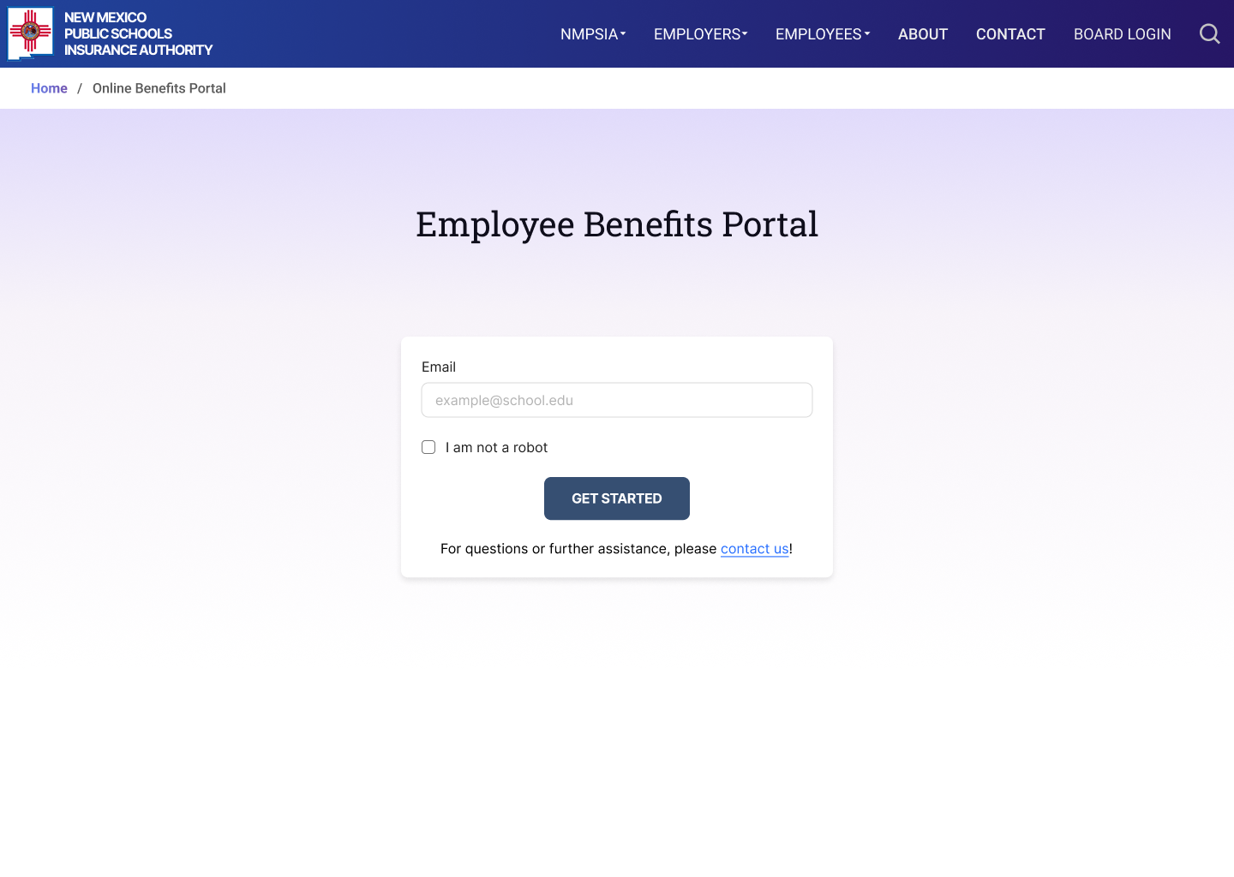
NEW USER 1. Enter the email you provided when you enrolled in NMPSIA benefits. 2. Certify you are not a robot. 3. Click GET STARTED.
1
2
3

Slide 4
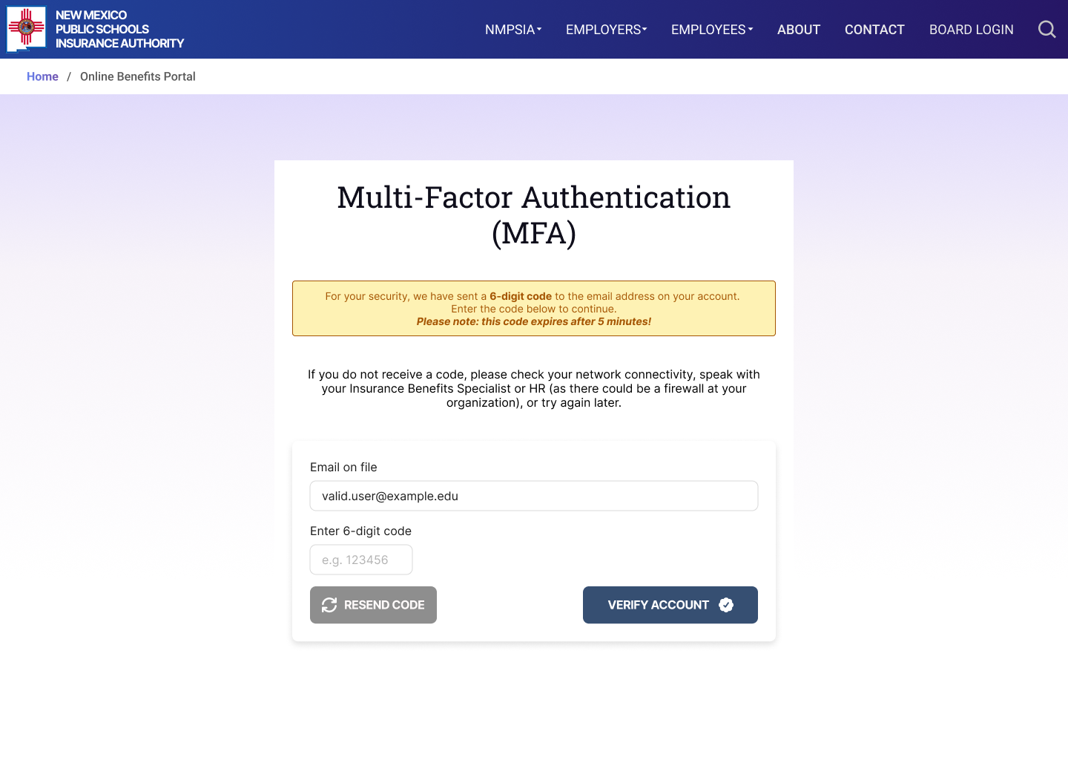
NEW USER A Multi- Factor Authentication (MFA) code will be sent to your email. 1. Enter the code and 2. Click VERIFY ACCOUNT Note: This code will expire after 5 minutes.
1
2

Slide 5
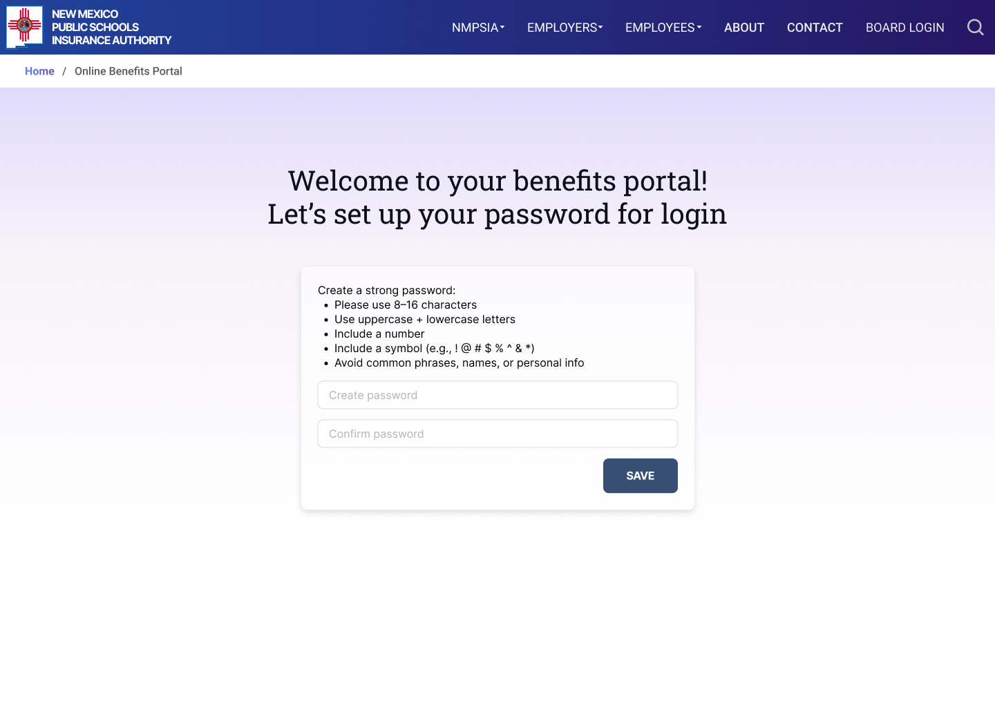
NEW USER You can now create a password which will be required to access your account moving forward. Create a password with the requested requirements. Confirm the password. Click SAVE.
1
2
3

Slide 6
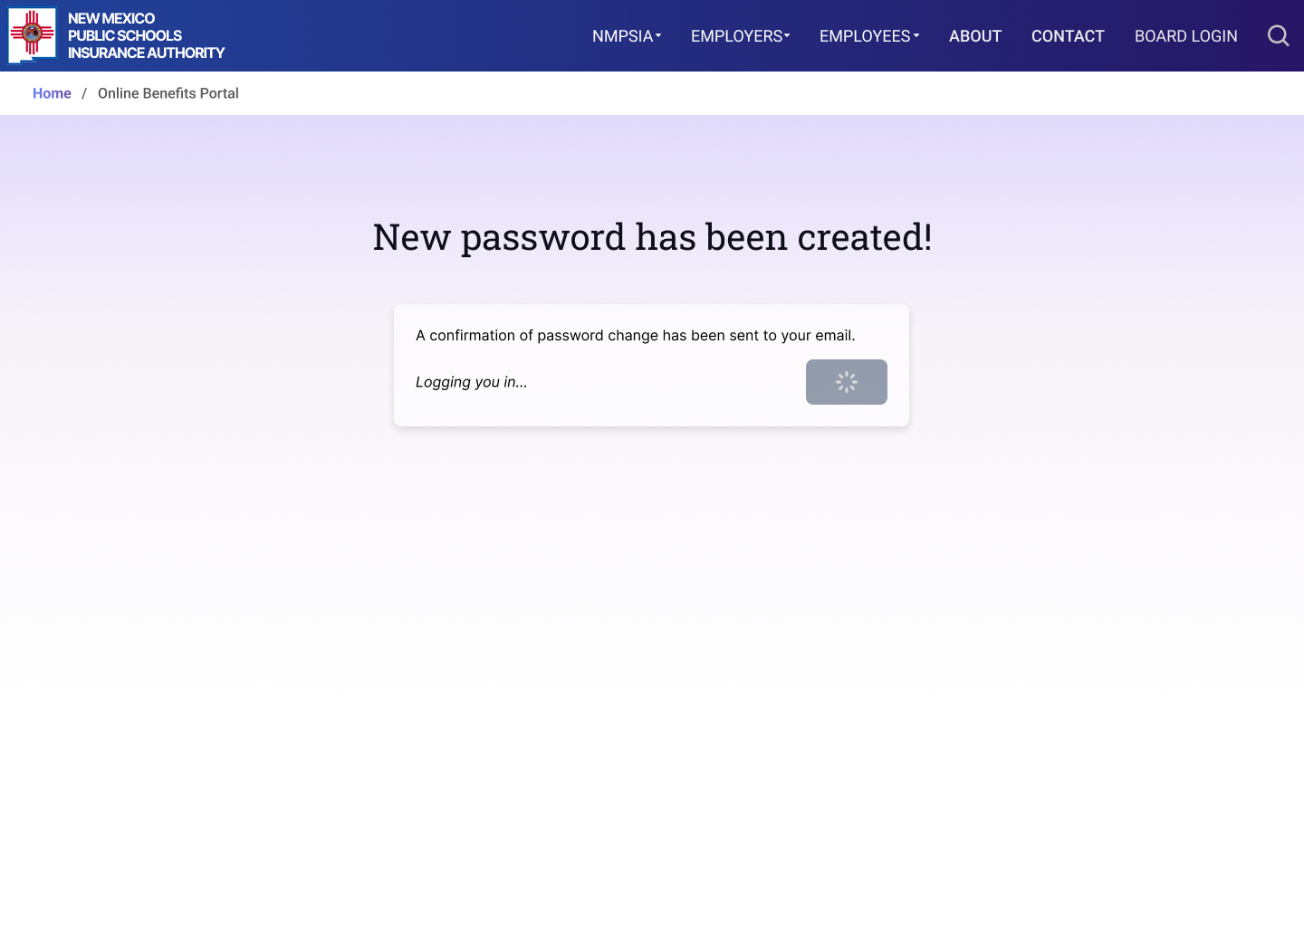
NEW USER You will see a message showing that your password has been created. You will automatically be logged in and will be allowed to access to the MyBenefits Portal.

Slide 7
EXISTING USER (already created a password) To access NMPSIA’s Benefits Portal Go to NMPSIA.com and Click on “Benefits Portal Login”

Slide 8
EXISTING USER 1. Enter the email you provided when you enrolled in NMPSIA benefits. 2. Certify you are not a robot. 3. Click GET STARTED.
1
2
3

Slide 9
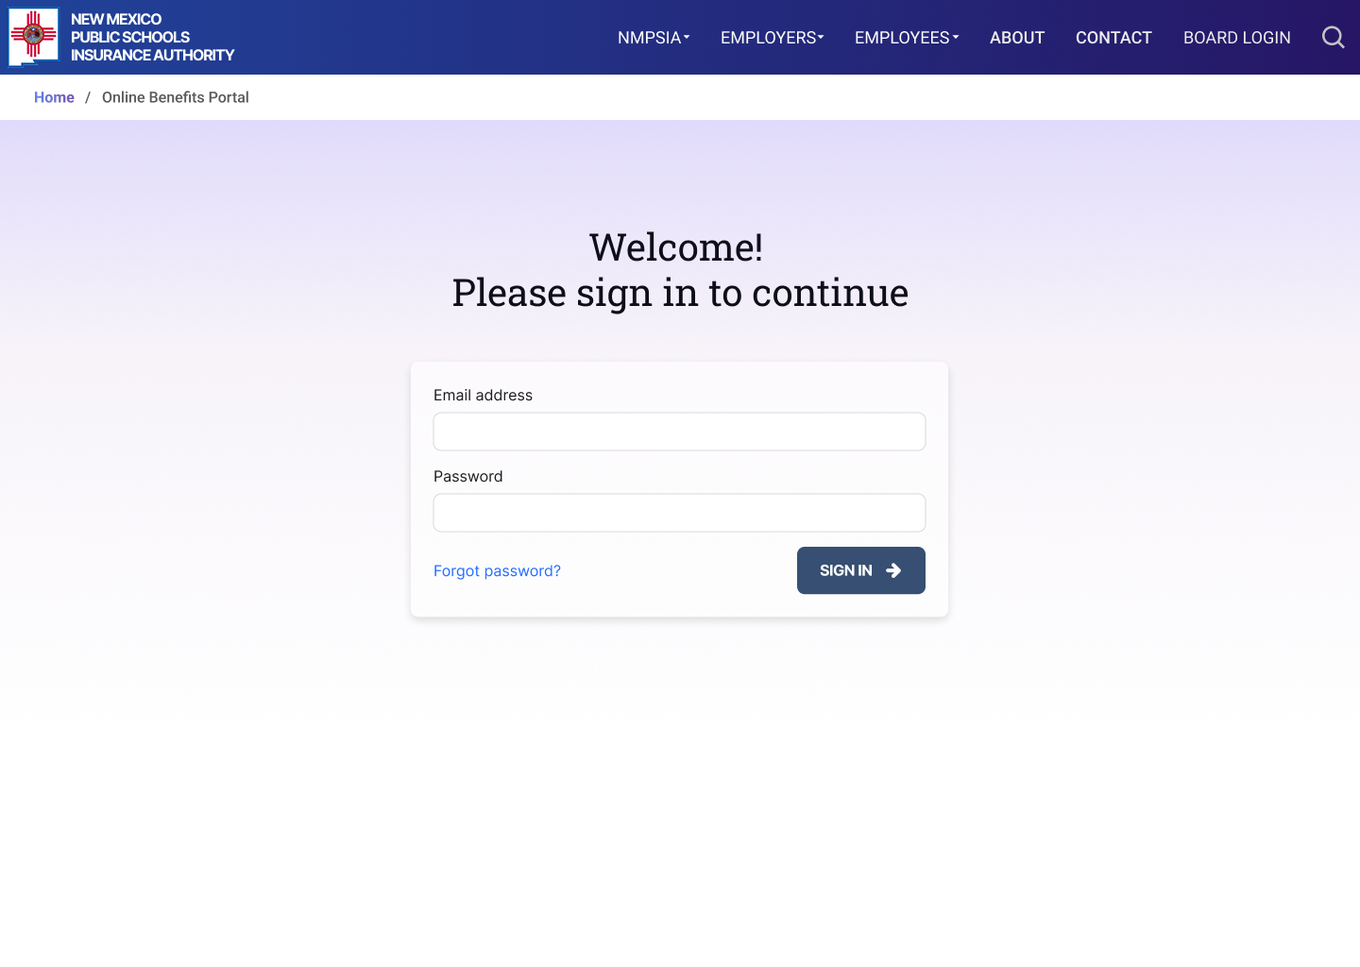
EXISTING USER Your email address will auto-populate in the designated field. Enter your password Click SIGN IN If you forgot your password, click “Forgot password” to create a new one.
1
2

Slide 10
EXISTING USER A Multi- Factor Authentication (MFA) code will be sent to your email. 1. Enter the code and 2. Click VERIFY ACCOUNT Note: This code will expire after 5 minutes.
1
2

Slide 11
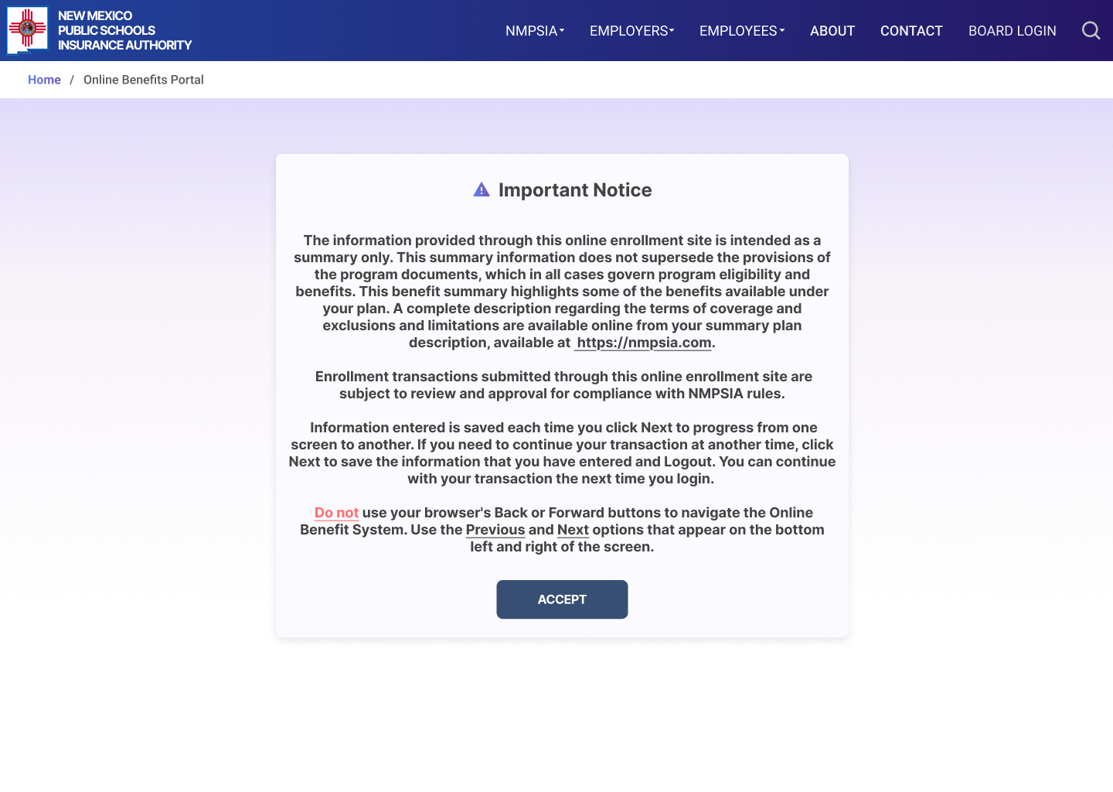
EXISTING USER Read the details under “Important Notice”, then click ACCEPT to continue.

Slide 12

FORGOT PASSWORD If you forget your password, use the “Forgot Password” feature.

Slide 13
FORGOT PASSWORD A Multi- Factor Authentication (MFA) code will be sent to your email. 1. Enter the code and 2. Click VERIFY ACCOUNT Note: This code will expire after 5 minutes.
1
2

Slide 14
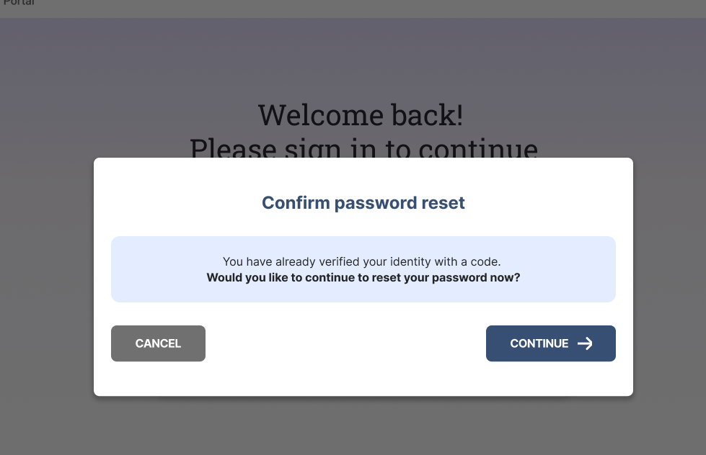
FORGOT PASSWORD You will be asked to confirm you would like to reset your password. Click CONTINUE to proceed.

Slide 15
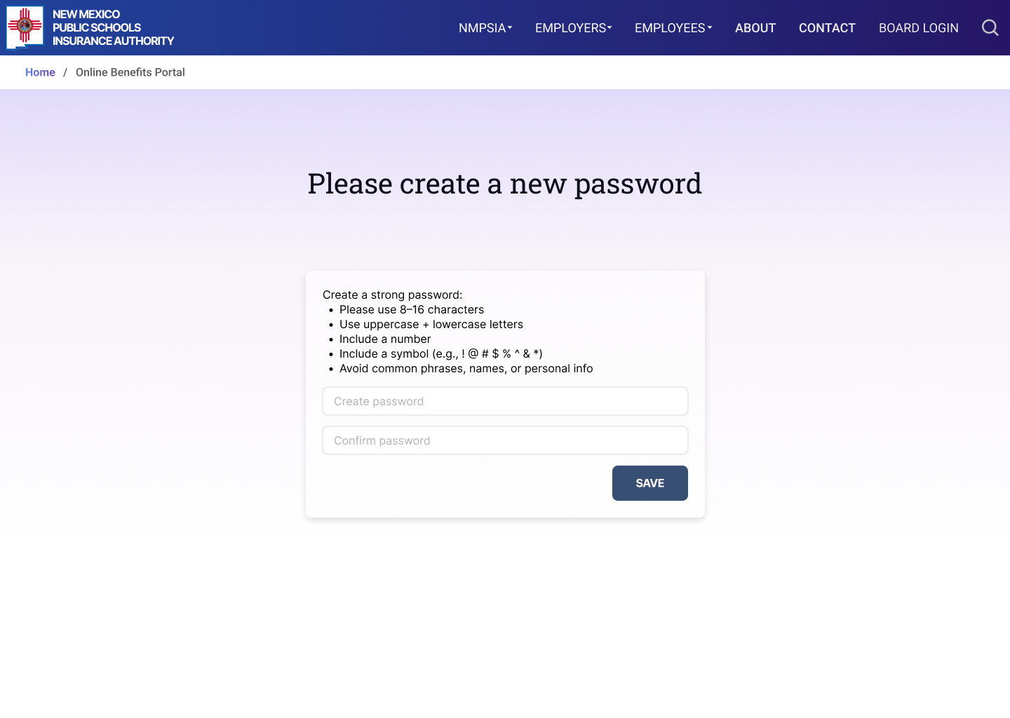
FORGOT PASSWORD You can now create a password which will be required to access your account moving forward. Create a password with the requested requirements. Confirm the password. Click SAVE.
1
2
3

Slide 16
FORGOT PASSWORD You will see a message showing that your password has been changed. You will automatically be logged in and will be allowed to access to the MyBenefits Portal.

Slide 17
FORGOT PASSWORD Read the details under “Important Notice”, then click ACCEPT to continue.

Slide 18
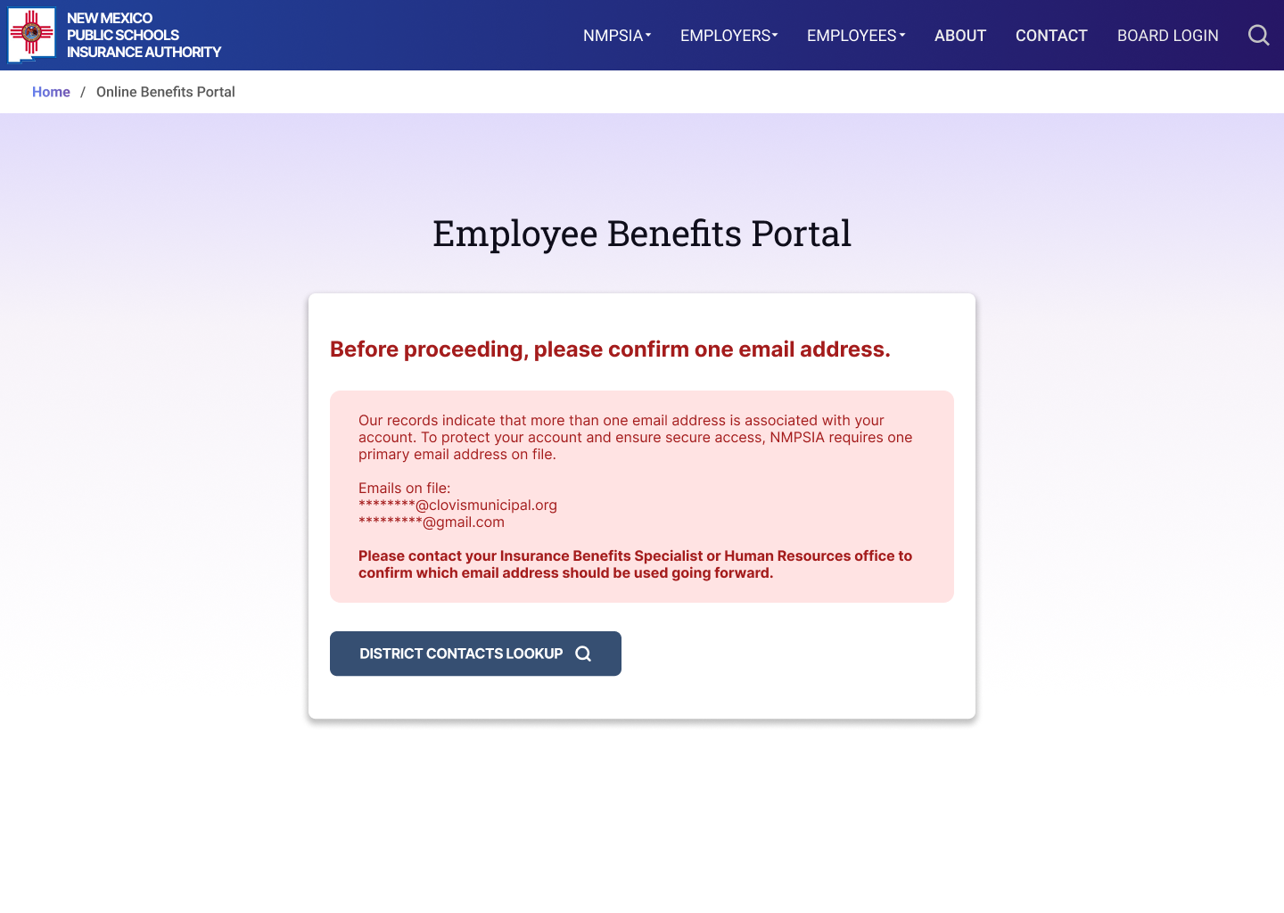
MERGE EMAIL- Notice If you receive this notice after entering your email on the initial login screen, you must contact your Benefits Specialist or Human Resources Department to correct your email address before you can view your benefits information.

Slide 19
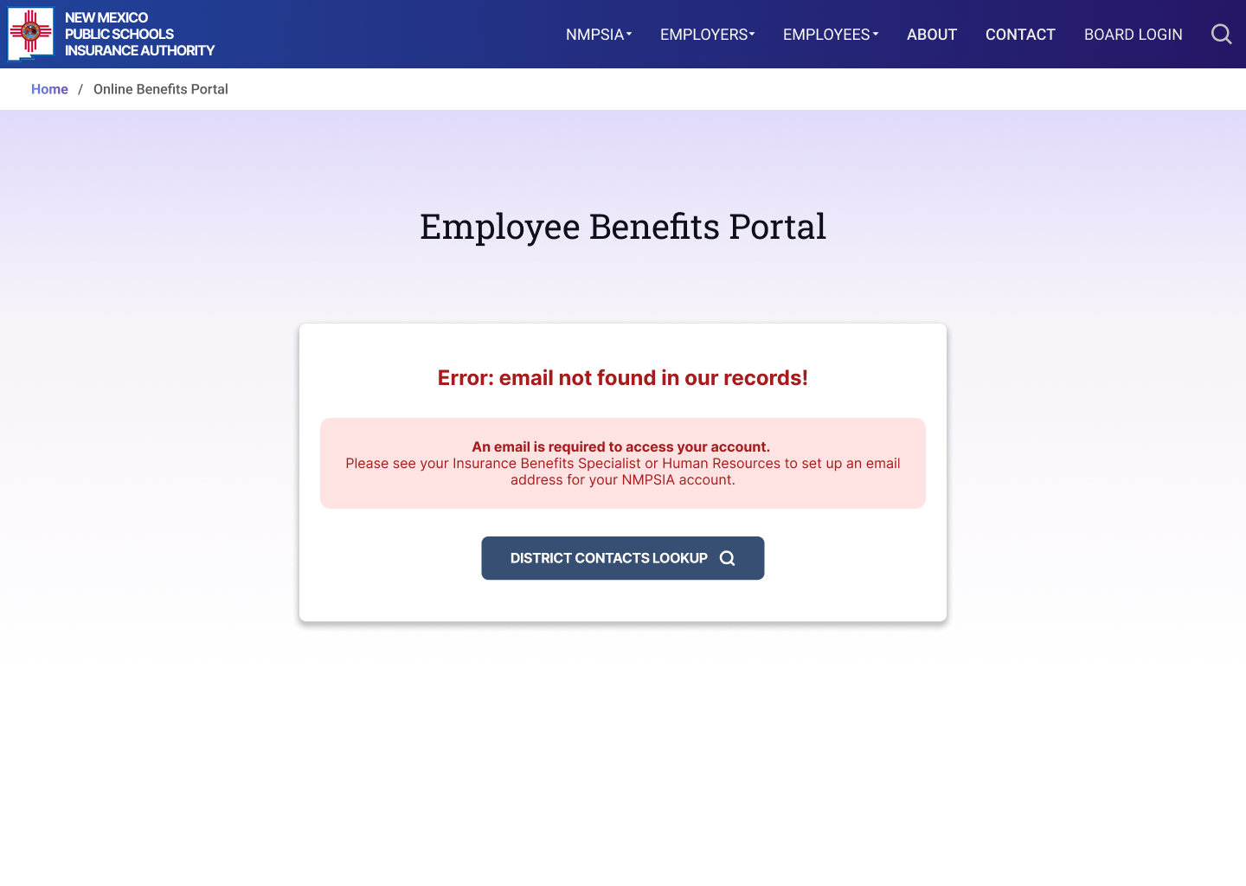
EMAIL NOT FOUND Notice If you receive this notice after entering an email, you do not have an email on file. Contact your Benefits Specialist or Human Resources Department for assistance. A valid email address is required before you can proceed.

Slide 20
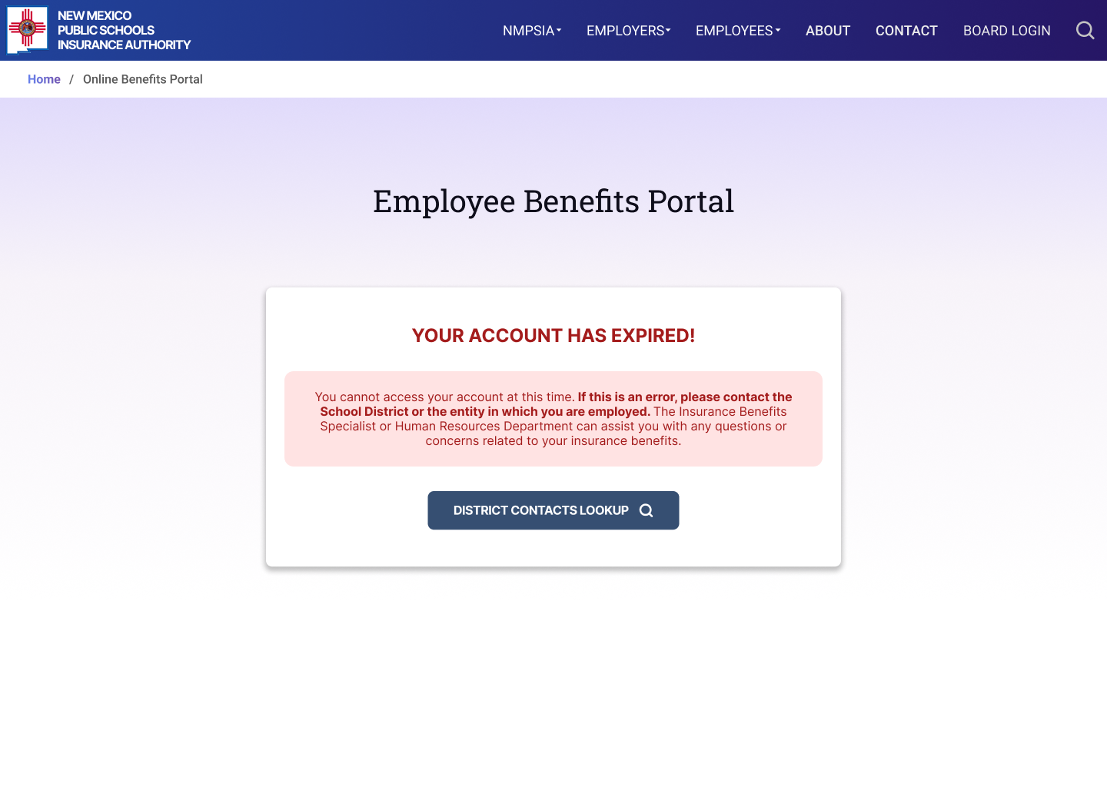
EXPIRED ACCOUNT If you receive this notice after entering an email, your account is not longer active. If you believe this is an error, please contact the School District or the entity with whom you are employed. The Benefits Specialist or Human Resources Department can assist you with any questions or concerns related to your insurance benefits.

